Slide 1
Endocrine System
Overview
Hypothalamus and pituitary gland
Other endocrine glands
Hormones and their actions
Stress and adaptation

Slide 2
Overview of Cell Communications
Necessary for integration of cell activities
Mechanisms
  gap junctions
    pores in cell membrane allow signaling chemicals to move from cell to cell
  neurotransmitters
    released from neurons to travel across gap to 2nd cell
  paracrine (local) hormones
    secreted into tissue fluids to affect nearby cells
  hormones (strict definition)
    chemical messengers that travel in the bloodstream

Slide 3
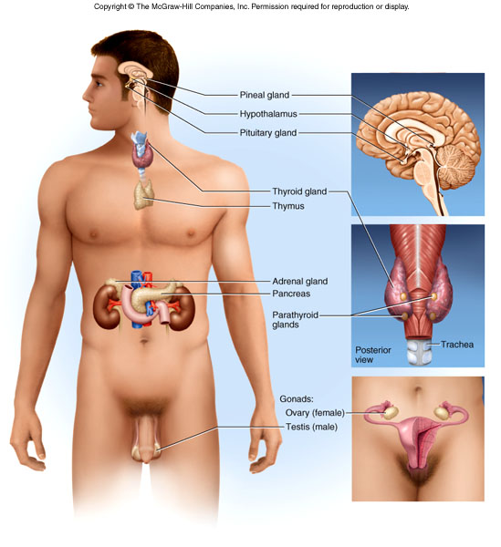
Endocrine Organs
Major organs of endocrine system

Slide 4
Hypothalamus
Shaped like a flattened funnel, forms floor and walls of third ventricle
Regulates primitive functions from water balance to sex drive
Many functions carried out by pituitary gland

Slide 5
Pituitary Gland (Hypophysis)
Suspended from hypothalamus by stalk (infundibulum)
Location and size
  housed in sella turcica of sphenoid bone
  1.3 cm diameter
Adenohypophysis (anterior pituitary)
  arises from hypophyseal pouch (outgrowth of pharynx)
Neurohypophysis
  arises from brain

Slide 6
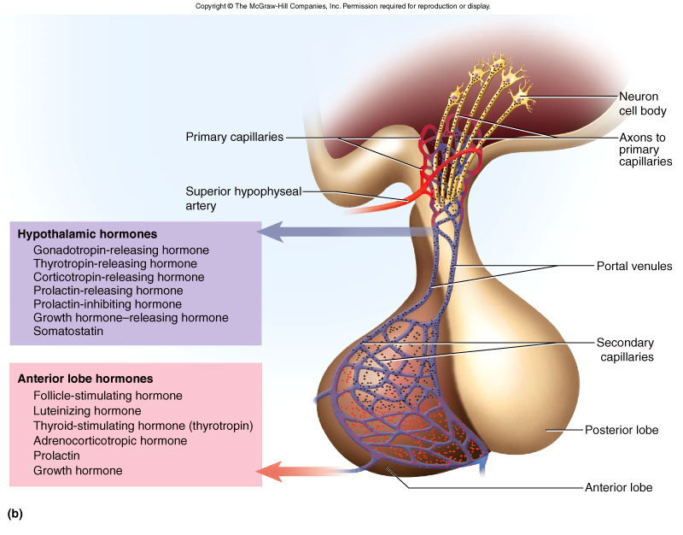
Hypothalamo-Hypophyseal Portal System
Hormones travel in portal system from hypothalamus to anterior pituitary
Hormones secreted by anterior pituitary

Slide 7
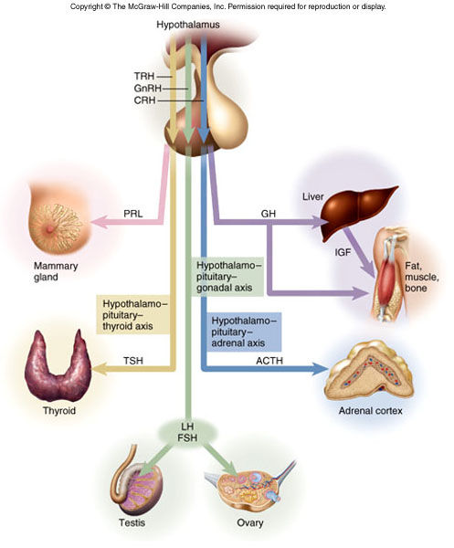
Anterior Pituitary Hormones
Principle hormones and target organs shown
Axis - refers to way endocrine glands interact

Slide 8
Pituitary Hormones - Posterior Lobe
OT (oxytocin) and ADH
  produced in hypothalamus
  transported by hypothalamo-hypophyseal tract to posterior lobe (stores then releases hormones)

Slide 9
Hormone Actions: Anterior Lobe
FSH (secreted by gonadotrope cells)
  stimulates production of egg or sperm cells
LH (secreted by gonadotrope cells)
  mainly stimulates hormone production
    females - stimulates ovulation and corpus luteum to secrete progesterone and estrogen
    males - stimulates interstitial cells of testes to secrete testosterone
TSH (secreted by thyrotropes)
  stimulates growth of gland and secretion of TH

Slide 10
Hormone Actions: Anterior Lobe
ACTH or corticotropin (secreted by corticotropes)
  regulates response to stress, stimulates adrenal cortex
    corticosteroids regulate glucose, fat and protein metabolism
PRL (secreted by lactotropes)
  female - milk synthesis after delivery
  male - ↑ LH sensitivity, thus ↑ testosterone secretion
GH or somatotropin

Slide 11
Growth Hormone
Secreted by somatotropes of anterior pituitary
Promotes tissue growth
  mitosis and cellular differentiation
  stimulates liver to produce IGF-I and II
    protein synthesis
      ↑ DNA transciption for ↑ mRNA production, proteins synthesized
      enhances amino acid transport into cells, ↓ protein catabolism
    lipid metabolism
      stimulates FFA and glycerol release from adipocytes, protein sparing
    CHO metabolism
      glucose sparing effect = less glucose used for energy
    Electrolyte balance
      promotes Na⁺, K⁺, Cl⁻ retention, Ca ²⁺ absorption

Slide 12
Abnormalities of Growth Hormone Secretion
Dwarfism if hyposecretion of growth hormone
Gigantism if oversecretion: hyperglycemia

Slide 13
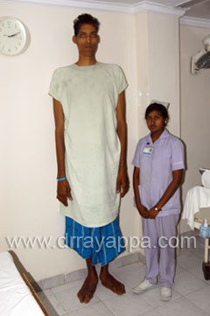
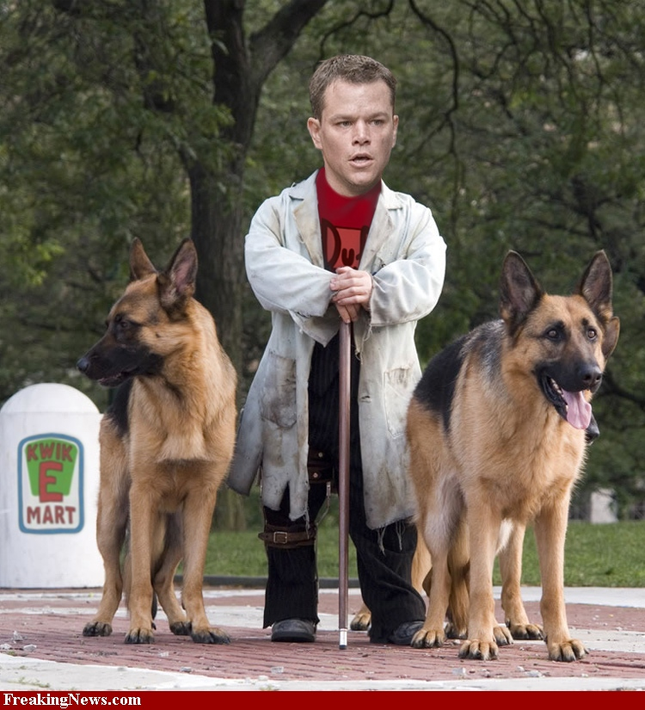

Slide 14
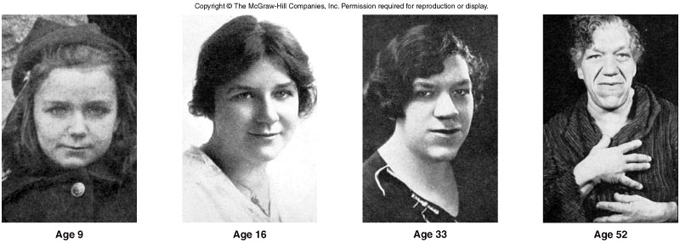
Cont…
Hypersecretion of growth hormones
  acromegaly
  thickening of the bones and soft tissues

Slide 15
Hormone Actions: Posterior Lobe
ADH
  targets kidneys
    ↑ water retention, reduce urine
  also functions as neurotransmitter
Oxytocin
  labor contractions, lactation

Slide 16
Control of Pituitary:
Hypothalamic and Cerebral Control
Anterior lobe control - releasing hormones and inhibiting hormones of hypothalamus
Posterior lobe control - neuroendocrine reflexes
  hormone release in response to nervous system signals
    suckling infant→ stimulates nerve endings → hypothalamus → posterior lobe → oxytocin → milk ejection
  hormone release in response to higher brain centers
    milk ejection reflex can be triggered by a baby's cry

Slide 17
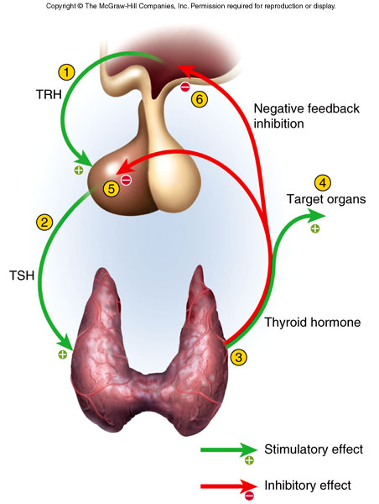
Control of Pituitary:
Feedback from Target Organs
Negative feedback
  ↑ target organ hormone levels inhibits release of tropic hormones
Positive feedback
  stretching of uterus ↑ OT release, causes more stretching of uterus, until delivery

Slide 18
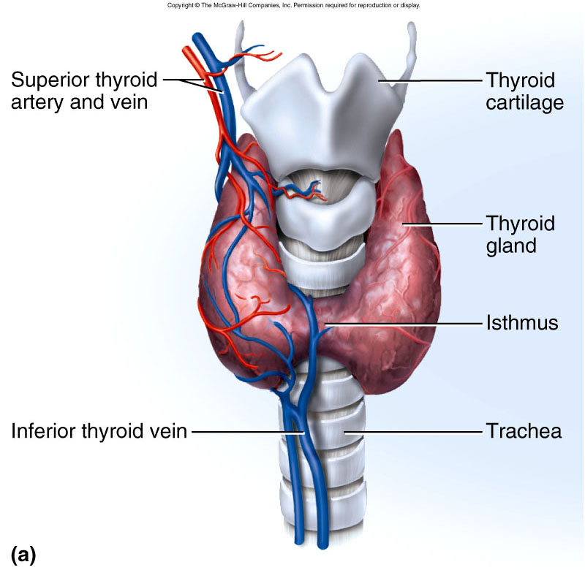
Thyroid Gland Anatomy
Fig. 17.9a
Largest endocrine gland; high rate of blood flow
  arises root of embryonic tongue
Anterior and lateral sides of trachea
  two large lobes connected by isthmus

Slide 19
Thyroid Gland
Thyroid follicles
  filled with colloid and lined with simple cuboidal epithelial (follicular cells) that secretes two hormones, T₃ and T₄
  thyroid hormone
    ↑ body’s metabolic rate and O₂ consumption
    calorigenic effect - ↑ heat production
    ↑ heart rate and contraction strength
    ↑ respiratory rate
    stimulates appetite and breakdown CHO, lipids and proteins
C (calcitonin or parafollicular) cells
  produce calcitonin that ↓ blood Ca²⁺ , promotes Ca²⁺ deposition and bone formation especially in children

Slide 20
Grave's disease: Autoimmune disease, where, TSH receptor stimulating antibody (TSI) is formed against the TSH receptors present in the thyroid follicular cell, making the gland hyperactive. Blood level of T3, T4 rise, TSH falls. Cytotoxic antibodies formed against the antigen common to extra ocular muscles & thyroid cause swelling of muscle & connective tissue within the bony eye orbit & pushes the eyeball out. Upper part of the sclera becomes visible [Exophthalmos]

Slide 21
Thyroid disease
Causes of hyperthyroidism: Grave's disease, solitary toxic adenoma, thyrotroph tumor, thyroiditis, mutation causing constitutive activation of TSH receptor, administration of TH, ectopic thyroid tissue.
Features: nervousness, irritability, restlessness, rapid mentation, weight loss, hyperphagia, heat intolerance, high pulse pressure, fine tremor of hands with stretched fingers, warm moist palm, increased BMR.

Slide 22
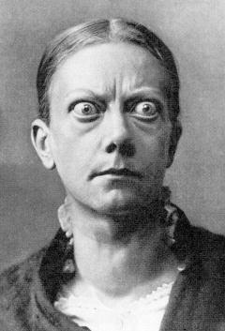
Grave’s Disease

Slide 23
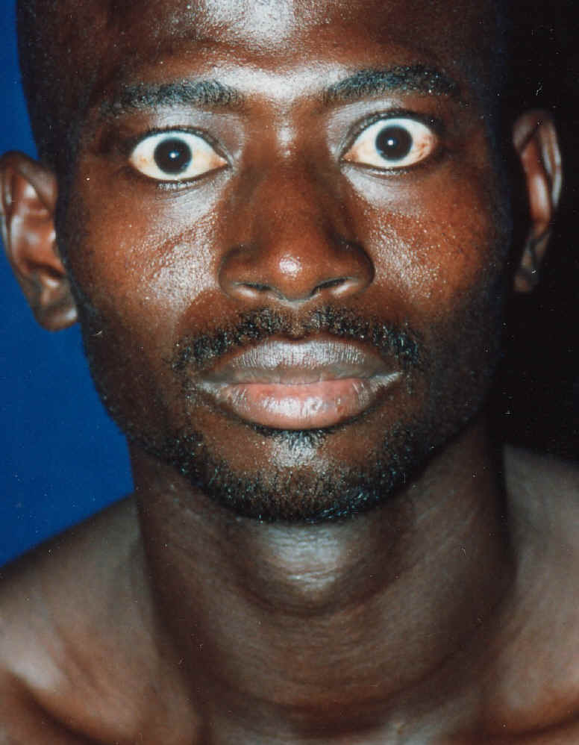
Grave’s Disease

Slide 24
Thyroid disease
Antibodies against thyroglobulin & thyroid peroxidase damage thyroid leading to hypothyroidism. [Hasimoto’s thyroiditis]
Causes of hypothyroidism: disease of thyroid, pituitary, or hypothalamus.
Features of myxedema [ hypothyroidism in adults]: Low BMR, coarse & sparse hair, dry yellow skin [carotenemia], slow husky voice, slow mentation, poor memory, cold intolerance, high cholesterol, madness, puffy face, non pitting edema [for accumulation of mucopolysaccharide, hyaluronic acid, chondroitin sulfate….those retain water & gives edematous look],.

Slide 25
Thyroid disease
Features of cretinism [ hypothyroidism in infants/children]: Dwarf, mentally retarded, deaf & dumb, pot-bellied, enlarged protruded tongue with dribbling saliva. Generally child of a hypothyroid mother.Rx. Rx. Minimum dose of TH . Treatment should be started within the 1st year of life.

Slide 26
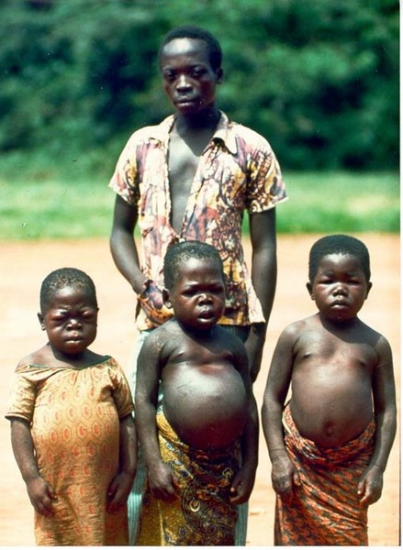
Cretinism

Slide 27
A goiter is simply an enlarged thyroid gland. It may be associated with hyperthyroidism, hypothyroidism, or euthyroidism, which means normal secretion of thyroid
hormone. In some places in the world, dietary iodine intake is inadequate; the resultant low level of thyroid hormone in the blood stimulates secretion of TSH, which causes thyroid gland enlargement

Slide 28
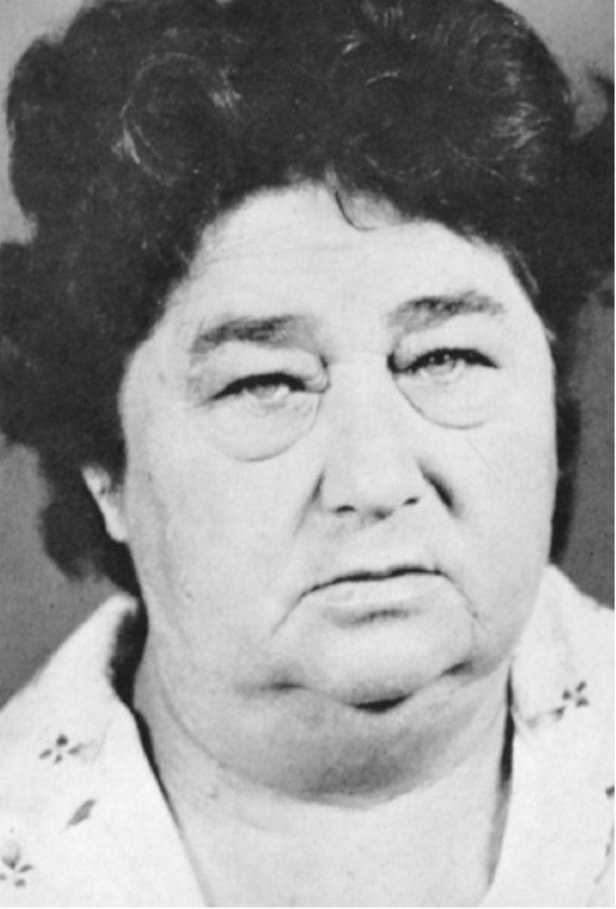
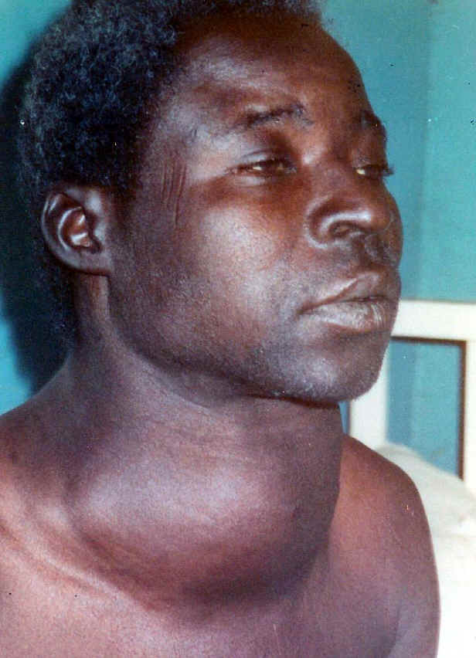
Myxedema

Slide 29
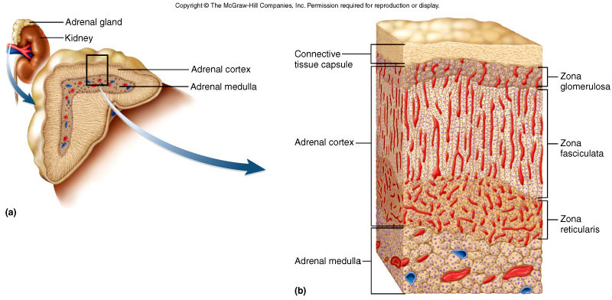
Adrenal Gland

Slide 30
Adrenal Medulla
Sympathetic ganglion innervated by sympathetic preganglionic fibers
  consists of modified neurons called chromaffin cells
  stimulation causes release of catecholamines (epinephrine, NE)
Hormonal effect is longer lasting
  Increases alertness, anxiety, or fear
  increases BP, heart rate and air flow
  raises metabolic rate
    inhibits insulin secretion
    stimulates gluconeogenesis and glycogenolysis
Stress causes medullary cells to stimulate cortex

Slide 31
Adrenal Cortex
Layers
  zona glomerulosa (outer)
  zona fasciculata (middle)
  zona reticularis (inner)

Slide 32
Adrenal Cortex
Corticosteroids
  mineralocorticoids (zona glomerulosa)
    control electrolyte balance, aldosterone promotes Na⁺ retention and K⁺ excretion
  glucocorticoids (zona fasciculata)
    especially cortisol, stimulates fat and protein catabolism, gluconeogenesis (from a.a.’s and FA’s) and release of fatty acids and glucose into blood
    anti-inflammatory effect becomes immune suppression with long-term use
  sex steroids (zona reticularis)
    androgen (including DHEA which other tissues convert to testosterone) and estrogen (important after menopause)

Slide 33
Cushing syndrome - excess cortical secretion
  hyperglycemia, hypertension, weakness, edema
  muscle and bone loss occurs with protein catabolism
  buffalo hump and moon face = fat
  deposition between shoulders or in face

Slide 34
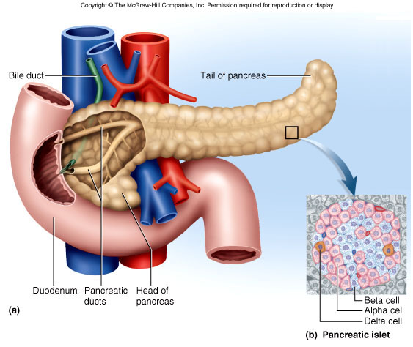
Pancreas
Retroperitoneal, inferior and dorsal to stomach

Slide 35
Pancreatic Hormones
1-2 million islets produce hormones
  98% of organ produces digestive enzymes (exocrine)
Insulin (from β cells)
  secreted after meal with carbohydrates raises glucose blood levels
  stimulates glucose and amino acid uptake
  nutrient storage effect (stimulates glycogen, fat and protein synthesis)
  antagonizes glucagon

Slide 36
Pancreatic Hormones
Glucagon (from α cells)
  secreted in very low carbohydrate and high protein diet or fasting
  stimulates glycogenolysis, fat catabolism (release of FFA’s) and promotes absorption of amino acids for gluconeogenesis

Slide 37
Pancreatic Hormones
Hyperglycemic hormones raise blood glucose
  GH, epinephrine, NE, cortisol and corticosterone
Hypoglycemic hormones lower blood glucose
  insulin

Slide 38
Diabetes Mellitus
Signs and symptoms of hyposecretion of insulin
  polyuria, polydipsia, polyphagia
  hyperglycemia, glycosuria, ketonuria
  osmotic diuresis
    blood glucose levels rise above transport maximum of kidney tubules, glucose remains in urine (ketones also present)
    increased osmolarity draws water into urine

Slide 39
Types of Diabetes Mellitus
Type I (IDDM) - 10% of cases
  some cases have autoimmune destruction of β cells, diagnosed about age 12
  treated with diet, exercise, monitoring of blood glucose and periodic injections of insulin
Type II (NIDDM) - 90%
  insulin resistance
    failure of target cells to respond to insulin
  3 major risk factors are heredity, age (40+) and obesity
  treated with weight loss program of diet and exercise
  oral medications improve insulin secretion or target cell sensitivity

Slide 40
Pathology of Diabetes
Acute pathology: cells cannot absorb glucose, rely on fat and proteins (weight loss, weakness)
  fat catabolism ↑ FFA’s in blood and ketone bodies
  ketonuria promotes osmotic diuresis, loss of Na⁺ and K⁺
  ketoacidosis occurs as ketones ↓ blood pH
    if continued causes dyspnea and eventually diabetic coma
Chronic pathology
  chronic hyperglycemia leads to neuropathy and cardiovascular damage from atherosclerosis
    retina and kidneys (common in type I), atherosclerosis leads to heart failure (common in type II), and gangrene

